Slide 1

Microsoft Azure
Manasi Lele

Slide 2
Agenda
Introduction to Cloud Computing
Types of Cloud Computing
Azure Global Infrastructure
Resource, Resource Groups, Subscription, Management Groups
Azure Core Services

Slide 3
What is cloud computing
On demand delivery of IT resources over the Internet with pay-as-you-go pricing
Enables you to build sophisticated, scalable applications
Use cases include
Enterprise IT applications, Backup & Storage
Website hosting, Mobile & Social Apps
Gaming, IoT
Big Data analytics and Machine Learning

Slide 4
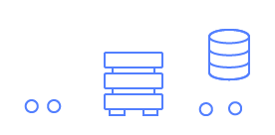
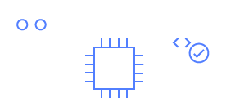

Types of cloud computing
Infrastructure as a Service (IaaS)
Contains the basic building blocks for cloud IT.
It typically provides access to networking features, computers (virtual or on dedicated hardware), and data storage space.
Highest level of flexibility and management control
Platform as a Service (PaaS)
Removes the need for you to manage underlying infrastructure
Example – Database Service, Managed Kubernetes Platform
Software as a Service (SaaS)
Provides with a complete product that is run and managed by the service provider

Slide 5
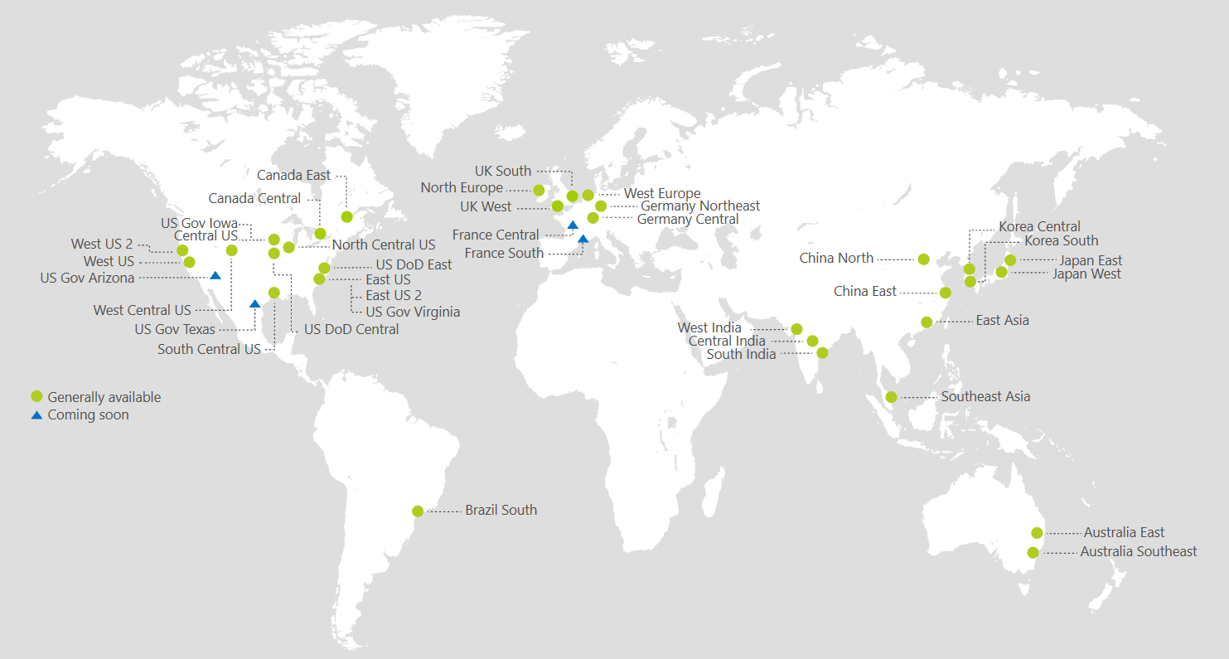
Azure Global Infrastructure
Azure Data Centers
Azure Regions
Azure Geographies
Azure Availability Zones
Azure Edge Zones
Azure Point of Presence
https://azure.microsoft.com/en-us/explore/global-infrastructure/

Slide 6
Azure Regions
Azure has Regions all around the world – 52 launched regions as of today
A region is a cluster of data canters
Azure regions are deployed in pairs. Each region is paired with another region in the same geopolitical boundary to provide resiliency if a catastrophic region failure occurs

Slide 7
Azure Region – How to choose ?
Azure Compliance with data governance and legal requirements: data never leaves a region without your explicit permission
Proximity to end customers: reduced latency
Available services within a Region: new services and new features aren’t available in every Region
Pricing: pricing varies region to region. Service pricing page lists pricing for all regions

Slide 8
Availability Zones
A minimum of three separate availability zones are present in all availability zone-enabled regions.
Each availability zone (AZ) is one or more discrete data centers with redundant power, networking, and connectivity
AZ’s are separate from each other, so that they’re isolated from disasters
AZ’s are connected with high bandwidth, ultra-low latency networking. Less than two millisecond roundtrip latency between Azs
https://learn.microsoft.com/en-us/azure/reliability/availability-zones-service-support

Slide 9
Management level and hierarchy
Resources are instances of services that you can create, such as virtual machines, storage, and SQL databases.
Resource groups are logical containers where you can deploy and manage Azure resources
Subscriptions logically associate user accounts with the resources that they create.
Subscription has limits or quotas on the amount of resources that it can create and use.
Organizations can use subscriptions to manage costs and the resources that are created by users, teams, and projects.
Management groups help you manage access, policy, and compliance for multiple subscriptions. All subscriptions automatically inherit the conditions that are applied to the management group.

Slide 10
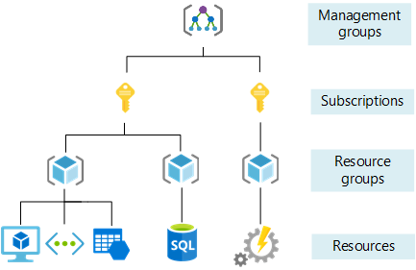
Management level and hierarchy

Slide 11
Azure Core Services

Slide 12
Virtual Networks
• Fundamental building block that offers your private network in Azure.
• No charge for using Azure Virtual Network; it's free of cost. However you pay for
the resources created inside Virtual Network
• By default, all resources in a virtual network can communicate outbound to the
internet
• Communicate inbound to a resource by assigning a public IP address or a public
load balancer
• When creating a virtual network, you must specify a custom private IP address
space
• Subnets enable you to segment the virtual network into one or more subnetworks
• A virtual network is scoped to a single region/location
• A virtual network is scoped to a subscription.

Slide 13
Understanding CIDR
Classless Inter-Domain Routing – a method for allocating IP addresses
They help to define an IP address range
A CIDR consists of two components
Base IP : Represents an IP contained in the range (XX.XX.XX.XX)
Example: 10.0.0.0, 192.168.0.0,
Subnet Mask- Defines how many bits can change in the IP. How many
addresses does a CIDR block represent? You calculate 232-Prefix , where
prefix is the number after the slash.
Example: /0, /24, /32
/8 => 255.0.0.0
/16 =>255.255.0.0
/24 => 255.255.255.0
/32 => 255.255.255.255
https://www.ipaddressguide.com/cidr

Slide 14
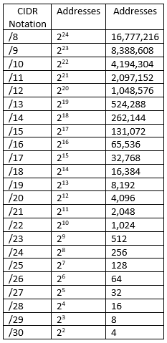
Understanding CIDR

Slide 15
Network Security Group (NSG)
Azure network security group are used to filter network traffic between Azure resources in an Azure virtual network
Evaluated and applied based on the five-tuple - source, source port, destination, destination port, and protocol)
You can't create two security rules with the same priority and direction
Network security group are stateful
If you specify an outbound security rule to any address over port then it's not necessary to specify an inbound security rule for the response to the outbound traffic. Same for inbound port as well
Existing connections may not be interrupted when you remove a security rule that allowed the connection.
Modifying network security group rules will only affect new connections
Rules are processed in priority order, with lower numbers processed before higher numbers
Any rules that exist with lower priorities (higher numbers) that have the same attributes as rules with higher priorities aren't processed.
A network security group is either assigned to a NIC or a subnet (preferred)

Slide 16
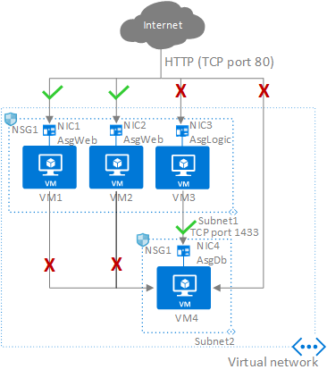
Application Security Groups (ASG)
Application Security Groups helps to manage the security of Virtual Machines by grouping them according the applications that runs on them.
ASGs are used within a NSG to apply a network security rule to a specific workload or group of VMs
This provides the capability to group VMs into associated groups or workloads, simplifying the NSG rule definition process
By implementing granular security traffic controls, we can improve isolation of workloads and can protect them individually
ASGs introduce the ability to deploy multiple applications within the same subnet and also isolate traffic based on ASGs.

Slide 17
Virtual Machines
Create VM
Enable ICMP protocol on VM
Create NSG rule to allow communication using ICMP from your desktop’s IP
Try to ping VM and check the result

Slide 18
Virtual Machine Types
General Purpose – Balanced CPU to memory ratio. Ideal for testing and development, small to medium databases and low to medium traffic web servers
B series, D Series
Compute Optimized - These give a higher CPU-to-memory ratio. These instances are good for medium traffic web servers, network appliances and application servers
F series
Memory optimized - These give a high memory-to-CPU ratio. This is good for hosting relational database servers, caching-based application and in-memory analytics.
E series
M series
Storage optimized - These give high disk throughput and IO, this is ideal for Big Data applications, SQL , NoSQL databases, data warehousing
L Series
GPU- Specialized virtual machine targeted for heavy graphic rendering as well as model training, inferencing and deep learning
N Series
High performance compute- Optimized for HPC such as Computational fluid dynamics, molecular dynamics, backend EDA etc.
H series

Slide 19
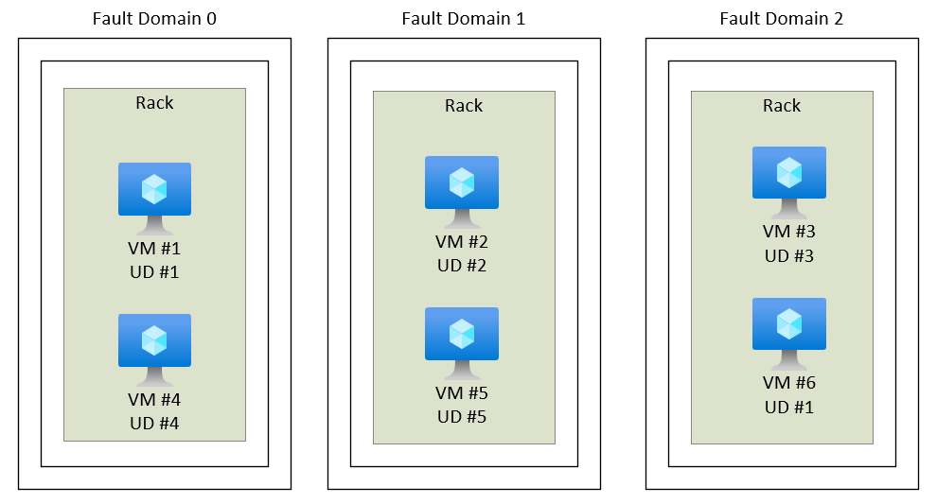
Availability Sets
An availability set is a logical grouping of VMs that allows Azure to understand how your application is built to provide for redundancy and availability within a data center
Availability set has Fault Domain and Update Domain
Fault domains define the group of virtual machines that share a common power source and network switch
Update domains indicate groups of virtual machines and underlying physical hardware that can be rebooted at the same time.
Availability set can be configured with up to three fault domains and twenty update domains.
Only one update domain is rebooted at a time.
A rebooted update domain is given 30 minutes
to recover before maintenance is initiated on a
different update domain.
VMs are also aligned with disk fault domains to
ensures that all the managed disks attached to
VM are within the same fault domains.

Slide 20
Virtual Machine Scale Set (VMSS)
Azure Virtual Machine Scale Sets let you create and manage a group of load balanced VMs. The number of VM instances can automatically increase or decrease in response to demand or a defined schedule.
Easy to create and manage multiple VMs
Provides high availability and application resiliency by distributing VMs across availability zones or fault domains
Allows your application to automatically scale as resource demand changes
Works at large-scale
VMSS orchestration modes –
Uniform Orchestration - Uses identical VM instances.
Individual Uniform VM instances are exposed via the Virtual Machine Scale Set VM API commands.
Flexible Orchestration - Uses identical or multiple virtual machine types.
Flexible orchestration offers high availability guarantees (up to 1000 VMs) by spreading VMs across fault domains in a region or within an Availability Zone
You can use all of the standard VM APIs when managing Flexible orchestration instances, instead of the Virtual Machine Scale Set VM APIs
Flexible orchestration mode can be used with all VM sizes.

Slide 21
Disk Storage
Microsoft has two offerings in the case of storage disks i.e. managed and unmanaged disk.
Unmanaged disks are deprecated in September 2022 and will be fully retiring by September 2025.
As of September 30, 2023, new customers won't be able to create unmanaged disks.
Unmanaged disks are a type of page blob in Azure that is used for storing Virtual Hard Disk (VHD) files associated with virtual machines. When a page blob VHD is attached to a VM, it functions as a virtual disk for that VM. Gives flexibility in Size and has GRS redundancy. Only available in HDD.
Azure managed disks are block-level storage volumes that are managed by Azure and used with Azure Virtual Machines. Just specify the disk size, the disk type, and provision the disk. Once provisioned, Azure handles the rest.
Highly durable and available –
Managed disks are designed for 99.999% availability.
Three replicas of your data allow for high durability.
Managed disks are integrated with availability sets

Slide 22
Disk Types
Azure Standard HDD - These disks are designed for low priority workloads. Standard HDD is based on magnetic drives. Standard HDD is the cheapest solution.
Example workloads for Standard HDD
Development
Testing
Backups
Disaster Recovery
Storage Price of Standard HDD -$0.048125 / GB per month
Azure Standard SSD - Standard SSD is designed for light to moderate use. Microsoft provide 99% capacity and performance thresholds but not guaranteed.
Example workloads for Standard SSD
Web servers
Application server
Enterprise application
Storage Price of Standard SSD
$0.075 / GB per month

Slide 23
Disk Types
Azure Premium SSD - Premium SSDs are designed for performance sensitive and for production environment. Only used with compatible VMs. Unlike standard SSD you will get reserved performance and capacity.
Example workloads for Premium SSD
Dynamics CRM
SQL Server
MongoDB
Cassandra
Storage Price of Premium SSD
$0.15 / GB per month
Azure Ultra-Disk - Ultra-Disk provides high throughput, high IOPs and low latency. Ultra-disk provides configurable capacity and performance features.
Example workloads for Ultra-Disk
SAP HANA
High throughput databases
Storage Price of Ultra-Disk
Price depends on disk configuration

Slide 24
Virtual Machine Lab
Create VM
Enable ICMP protocol on VM
Create NSG rule to allow communication using ICMP from your desktop’s IP
Try to ping VM and check the result

Slide 25
Azure Storage
The Azure Storage platform includes the following data services:
Azure Blobs: A massively scalable object store for text and binary data. Also includes support for big data analytics through Data Lake Storage Gen2.
Azure Files: Managed file shares for cloud or on-premises deployments.
Azure managed Disks: Block-level storage volumes for Azure VMs.
Azure Queues: A messaging store for reliable messaging between application components.
Azure Tables: A NoSQL store for schema less storage of structured data.
Azure Elastic SAN (preview): A fully integrated solution that simplifies deploying, scaling, managing, and configuring a SAN in Azure.

Slide 26
Azure Monitor
Data to observe and take action on:
Azure AD: Retention period 7 days (For basic) to 30 days ( For Premium)
Sign-ins
Audit
Subscription Level : Retention period is 90 days
Activity Logs
Service Health
Resource Level: Retention period is 93 days
Metrics – CPU, Memory etc. varies based on resource type
Custom:
Application logs
OS logs etc.

Slide 27
Azure Monitor :
How to get capture everything at one place ?
Diagnostic Settings: Configure streaming export of platform logs and metrics for a resource to destination of your choice. Can also be configured via Azure Policy .Create upto 5 settings to send data to independent destination
Export to Azure Storage :
Long term archival
Very cheap
Export to Event Hubs:
Connect with external SIEM
Log Analytics Workspace:
Rich Analytics, Kusto Query Language (KQL) for easier querying, Use ML to point deviation from normal behavior

Slide 28
Azure Monitor :
Azure Monitor Agent (AMA):
Collect monitoring data from guest OS and deliver it Azure Monitor
Replaces legacy log analytics agent, diagnostic extension, telegraph (for linux)
Can send data to
Log Analytics Workspace
Metrics as custom metrics
Data Collection Rules:
Centrally define what to collect for AMA
Replaces legacy log analytics agent, diagnostic extension, telegraph (for linux)

Slide 29
Azure Monitor :
Log Analytics Workspace
Pay for data ingestion
Pay for retention
2 Year max retention which is configurable
To reduce cost, optimize the duration when you send data and retention period
By default stores logs as “Analytics Logs”
Also offers basic logs :
Cheaper but not for bigger analytics.
Stored only for 8 days.
Limited querying capabilities
Archive Logs: Can be archived up to 7 years. cannot be used for interactive querying.
Implement Search jobs to pull data into analytics log table
Or Restore specific logs ( in a_RT table)

Slide 30
Azure Databases

Slide 31
Types Of database
Relational Databases
A prevalent technology for decades - mature, proven, and widely implemented.
Relational databases provide a store of related data tables.
These tables have a fixed schema, use SQL (Structured Query Language) to manage data, and support ACID guarantees.
No-SQL Databases
No-SQL databases refer to high-performance, non-relational data stores.
Offer ease-of-use, scalability, resilience, and high availability .
Instead of joining tables of normalized data, NoSQL stores unstructured or semi-structured data, often in key-value pairs or JSON documents.
No-SQL databases typically don't provide ACID guarantees beyond the scope of a single database partition. High volume services that require sub second response time favor NoSQL datastores.

Slide 32
Types Of database
Use Relational Databases when -
Your workload volume generally fits within thousands of transactions per second
Your data is highly structured and requires referential integrity
Relationships are expressed through table joins on normalized data models
You work with complex queries and reports
Data is typically centralized, or can be replicated regions asynchronously
Your application will be deployed to large, high-end hardware
Use No-SQL Databases when -
You have high volume workloads that require predictable latency at large scale (e.g. latency measured in milliseconds while performing millions of transactions per second)
Your data is dynamic and frequently changes
Relationships can be de-normalized data models
Data retrieval is simple and expressed without table joins
Data is typically replicated across geographies and requires finer control over consistency, availability, and performance
Your application will be deployed to commodity hardware

Slide 33
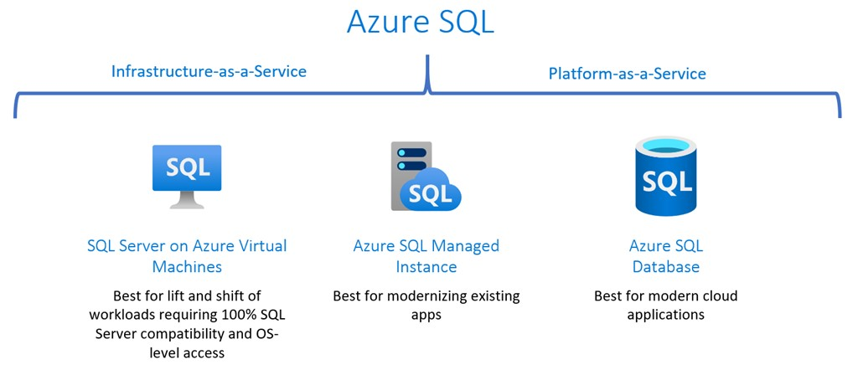
Azure SQL

Slide 34
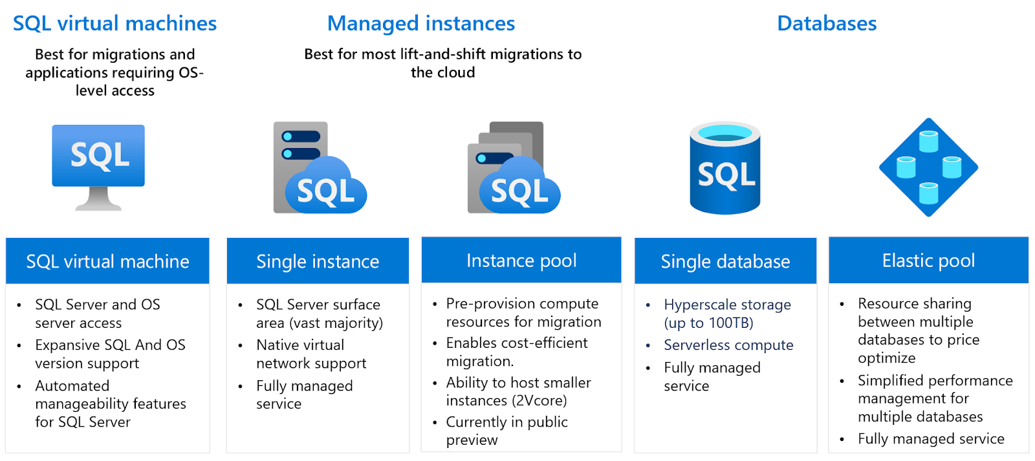
Azure SQL

Slide 35
Azure Database for PostgreSQL/MySQL/MariaDB
Built on community editions of open source relational database
PostgreSQL
Single server (Legacy)
Flexi Server
VM Based ( Hence support for B Series)
Stop-start
High Availability
Easier DR strategies
Cosmos DB for PostgreSQL
Citus extension – Distributed table

Slide 36
Azure Database for PostgreSQL/MySQL/MariaDB
Built on community editions of open source relational database
MySQL
Single server (Legacy)
Flexi Server
VM Based ( Hence support for B Series)
Stop-start
High Availability
Easier DR strategies
MariaDB
Single server

Slide 37
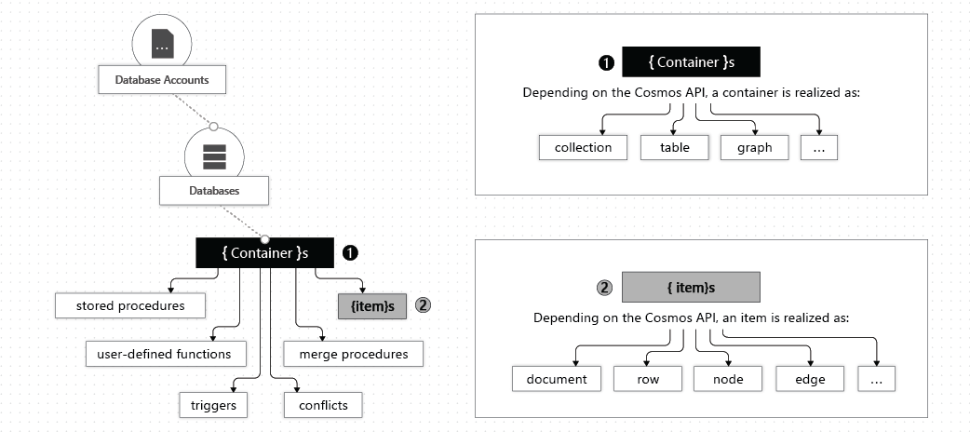
Cosmos DB
Azure Cosmos DB account: Hold database and containers.
Cosmos DB account contains a unique DNS name
A maximum of 50 Azure Cosmos DB accounts can be created under an Azure subscription. This limitation is a soft limit that can be increased via support request.
A database is simply a group of containers.
Containers hold items

Slide 38
Cosmos DB
The items in a container are divided into distinct subsets called logical partitions.
Logical partitions are formed based on the value of a partition key that is associated with each item in a container. All the items in a logical partition have the same partition key value.
The partition key is used to route data to the appropriate partition to be written, updated, or deleted.
The partition key can also be used in the WHERE clause in queries for efficient data retrieval.
There's no limit to the number of logical partitions in your container. Each logical partition can store up to 20 GB of data
Internally, one or more logical partitions are mapped to a single physical partition. Typically smaller containers have many logical partitions but they only require a single physical partition. Unlike logical partitions, physical partitions are an internal implementation of the system and Azure Cosmos DB entirely manages physical partitions.
The number of physical partitions in your container depends on the following characteristics:
The amount of throughput provisioned (each individual physical partition can provide a throughput of up to 10,000 request units per second).
The total data storage (each individual physical partition can store up to 50 GBs of data).

Slide 39
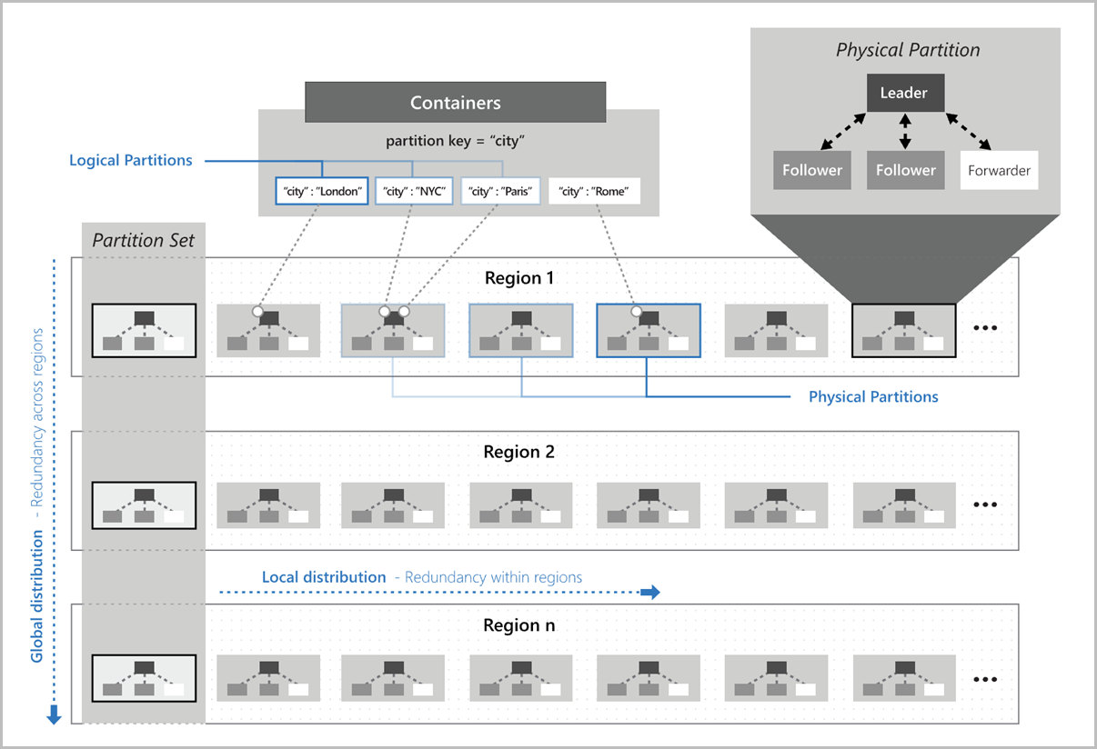
Cosmos DB

Slide 40
Developer Tools

Slide 41
Control Plane and Data Plane
Control plane is used to manage resources in your subscription.
Data plane is used to use capabilities exposed by your instance of a resource type.
For example:
You create a virtual machine through the control plane. After the virtual machine is created, you interact with it through data plane operations, such as RDP
You create a storage account through the control plane. You use the data plane to read and write data in the storage account.
All requests for control plane operations are sent to the Azure Resource Manager URL. That URL varies by the Azure environment.
For Azure global, the URL is https://management.azure.com.
For Azure Government, the URL is https://management.usgovcloudapi.net/.
For Azure Germany, the URL is https://management.microsoftazure.de/.
For Microsoft Azure China 21Vianet, the URL is https://management.chinacloudapi.cn.

Slide 42
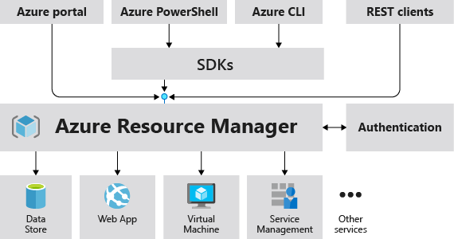
Azure Resource Manager

Slide 43
Developer Tools
Azure Portal
Web-based graphical interface for managing Azure services.
It provides a unified, scalable, and secure way to manage resources and services in Azure
Azure CLI
Command-line interface for managing Azure services.
It provides a set of commands for performing various tasks related to Azure, including creating and managing virtual machines, storage accounts, databases, and other Azure services.
The Azure CLI is cross-platform, meaning it can be used on Windows, macOS, and Linux.
Install CLI - https://learn.microsoft.com/en-us/cli/azure/install-azure-cli
https://learn.microsoft.com/en-us/cli/azure/reference-index?view=azure-cli-latest

Slide 44
Developer Tools
Azure PowerShell
Azure PowerShell is an extension of windows PowerShell that has its modules and cmdlets to perform powerful common tasks on the Azure cloud bypassing the need of the Azure Portal.
Users can create automation scripts using PowerShell for repetitive tasks on the cloud resulting in a drastic decrease in Administrative overhead.
Install- https://learn.microsoft.com/en-us/powershell/azure/install-azure-powershell?view=azps-10.0.0
https://learn.microsoft.com/en-us/powershell/module/?view=azps-10.0.0
https://github.com/Azure/azure-docs-powershell-samples
Azure Cloud Shell
Browser-accessible terminal for managing Azure resources.
It provides the flexibility of choosing the shell experience that best suits the way you work, either Bash or PowerShell.
Runs on a temporary host provided on a per-session, per-user basis.

Slide 45
Developer Tools
ARM Templates
A JavaScript Object Notation (JSON) file that defines the infrastructure and configuration for your project
No need to write the sequence of programming commands to create resource For example, you can deploy not only virtual machines, but also the network infrastructure, storage systems, and any other resources you may need.
You deploy the template through one command, rather than through multiple imperative commands
Repeatedly deploy your infrastructure throughout the development lifecycle in a consistent manner
Templates are idempotent, which means you can deploy the same template many times and get the same resource types in the same state.
Resource Manager orchestrates the deployment of interdependent resources so they're created in the correct order.

Slide 46
Developer Tools
ARM Templates
Nest one template inside another template.
As soon as a resource provider introduces new resources, you can deploy those resources through templates.
Use the what-if operation to get a preview of changes before deploying the template.
Template is deployed only after passing validation.
Deployments are tracked. In the Azure portal, you can review the deployment history and get information about the template deployment.
policy remediation is done on non-compliant resources when deployed through templates.
By using Azure DevOps and Resource Manager template task, you can use Azure Pipelines to continuously build and deploy ARM template projects.
You can get a template for an existing resource group by exporting the current state

Slide 47
Developer Tools
ARM Templates
The template has the following sections:
Parameters - Provide values during deployment that allow the same template to be used with different environments.
Variables - Define values that are reused in your templates. They can be constructed from parameter values.
User-defined functions - Create customized functions that simplify your template.
Resources - Specify the resources to deploy.
Outputs - Return values from the deployed resources.

Slide 48
Developer Tools
Azure Bicep
A transparent abstraction over ARM and ARM templates. It simplifies the authoring experience by providing a cleaner syntax and better support tooling.
Bicep offers a concise and readable syntax compared to the verbose JSON format of ARM templates.
Bicep has integrated tooling support, including IntelliSense, code highlighting, and linting, which makes the authoring experience better.
Bicep supports modularization, allowing you to create and reuse modules across your deployment projects.
Bicep Playground enables you to view equivalent ARM template and Bicep files side by side. You can select Sample Template to see both versions. Or, select Decompile to upload your own ARM template and view the equivalent Bicep file.

Slide 49
Developer Tools
Azure Bicep Advantages:
Readability: Clearer syntax ensures that code reviews and modifications are easier.
Maintainability: Reduced complexity and better tooling support lead to easier maintenance.
Integrated Tooling: With tools like VS Code, Bicep has excellent IntelliSense, linting, and code highlighting.
There are some alternatives to Bicep like Terraform, Farmer, or Pulumi. However, the main difference, Bicep will transpile into ARM-JSON templates, which is the native notation that Azure understands. The runtime is unchanged; Bicep only provides an abstract layer and reduces the pain of working with JSON.

Slide 50
Containerization

Slide 51
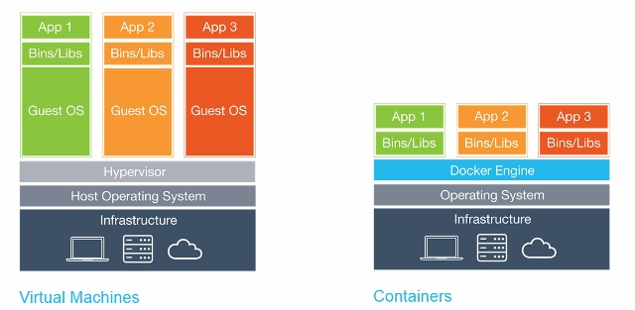
Containers

Slide 52
Introduction to Containerized Workloads
Azure Kubernetes Service:
Azure Kubernetes Service (AKS) simplifies the deployment of managed Kubernetes in Azure
AKS handles most of the complexity and operational tasks related to managing Kubernetes—including tasks like health monitoring, upgrades, and networking. AKS manages Kubernetes master nodes, while customers manage and maintain agent nodes.
AKS is a free managed service. Customers are only required to pay for agent nodes used by the clusters. There is no need to pay for any of the masters, which are configured and deployed by AKS.

Slide 53
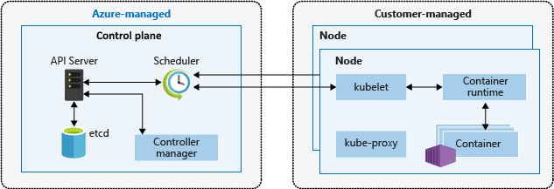
Azure Kubernetes Service

Slide 54
Azure Load Balancer
Operates at Layer 4 of OSI model
Public or private
Backend pool can be NIC or IP range
Uses 5 tuples hashing algorithm for load distribution– Source IP, Destination IP, Source Port, Destination Port, Protocol
Session affinity distribution mode uses two-tuple or three-tuple based load balancing.
Offers Basic, Standard, Gateway SKU
Protocols supported - TCP, UDP
Basic – To be retired by 2025
Standard SKU offers Zonal redundancy options
Gateway SKU - catered for third-party network virtual appliances (NVAs). With this SKU , you can insert appliances of your choice for different kinds of scenarios such as: Firewalls, Advanced packet analytics, Intrusion detection and prevention systems, Traffic mirroring, DDoS protection ( Non native/Custom network appliances )
Can support global or regional load balancing depending on configuration

Slide 55
Azure Application Gateway
Operates at Layer 7 of OSI model
Public or public+private
Backend pool can be VM, VMSS, App Service, Container, FQDN..
Application Gateway can make routing decisions based on additional attributes of an HTTP request, for example URI path or host headers
SKU offered - Standard v1, v2 and WAF – v1,v2
Offers SSL termination,
Autoscaling
Zonal Redundancy
Session affinity
Custom error pages
WebSocket support
HTTP/2 support.. Etc.
https://learn.microsoft.com/en-us/azure/application-gateway/overview-v2#feature-comparison-between-v1-sku-and-v2-sku
Regional load balancing

Slide 56
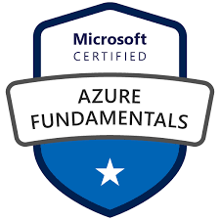
Azure Certification – Foundational
Checks the foundational knowledge of cloud services.
The exam is intended for candidates who are just beginning to work with cloud-based solutions and services or are new to Azure.
Exam AZ 900 : Microsoft Azure Fundamentals -
Candidate should have knowledge of cloud concepts, Azure services, Azure workloads, security and privacy in Azure, as well as Azure pricing and support.
Candidates should be familiar with the general technology concepts, including concepts of networking, storage, compute, application support, and application development.

Slide 57
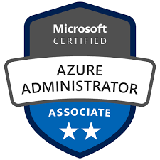
Azure Administrator
Administrators provision, monitor and maintain Azure solutions.
Exam AZ-104: Microsoft Azure Administrator– Candidates should have subject matter expertise in implementing, managing, and monitoring Azure environment. Focus on virtual networks, storage, compute, identity, security, and governance

Slide 58
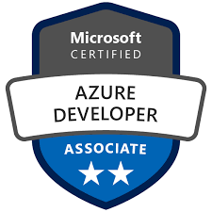
Azure Developer
Responsible for participating in all phases of development, including requirements gathering, design, development, deployment, security, maintenance, performance tuning, and monitoring.
Candidates partner with cloud solution architects, DBAs, DevOps, infrastructure admins, and other stakeholders to implement solutions.
Exam AZ-204: Developing Solutions for Microsoft Azure– Candidates should be proficient in Azure: SDKs, data storage options, data connections, APIs, app authentication/authorization, compute/container deployment, and debugging.

Slide 59
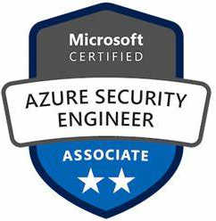
Azure Security Engineer
Security engineer implements, manages, and monitors security for resources in Azure, multi-cloud, and hybrid environments as part of an end-to-end infrastructure.
They recommend security components and configurations to protect identity & access, data, applications, and networks.
Exam AZ-500: Microsoft Azure Security Technologies-
Measures your ability to accomplish the following technical tasks: manage identity and access; secure networking; secure compute, storage, and databases; and manage security operations.

Slide 60
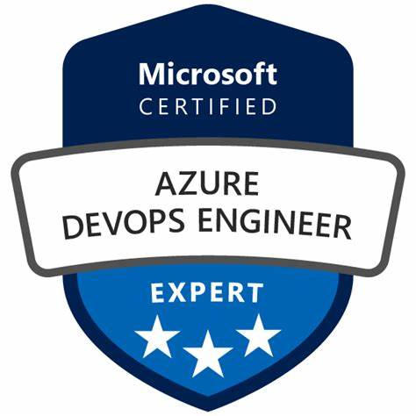
Azure DevOps Engineer
Subject matter expertise in working with people, processes, and products to enable continuous delivery of value in organizations.
Responsible for designing and implementing strategies for collaboration, code, infrastructure, source control, security, compliance, continuous integration, testing, delivery, monitoring, and feedback.
Exam AZ-400: Designing and Implementing Microsoft DevOps Solutions -Candidates should be proficient in Azure: SDKs, data storage options, data connections, APIs, app authentication/authorization, compute/container deployment, and debugging.
Prerequisite to get the DevOps Engineer badge: Complete one of the following
OR

